Slide 1
CALLBACK
KICKOFF
monday june 2

Slide 2
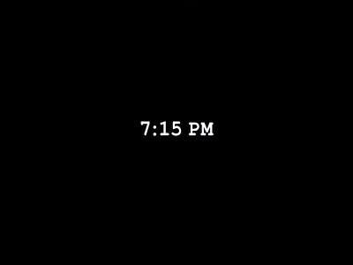

Slide 3

An Original Comedy Musical

Slide 4

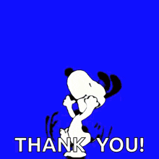
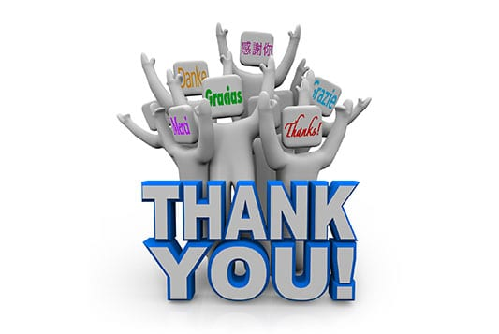


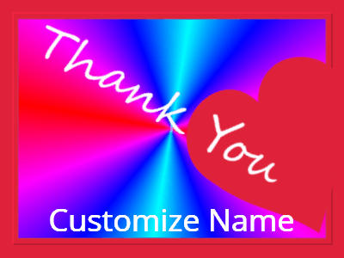
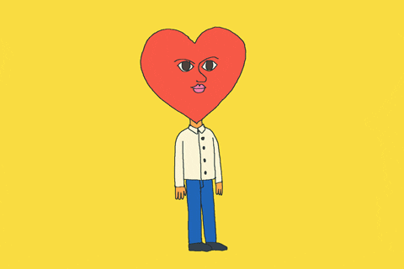

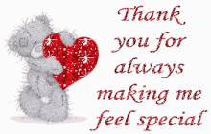
first … thank you

Slide 5
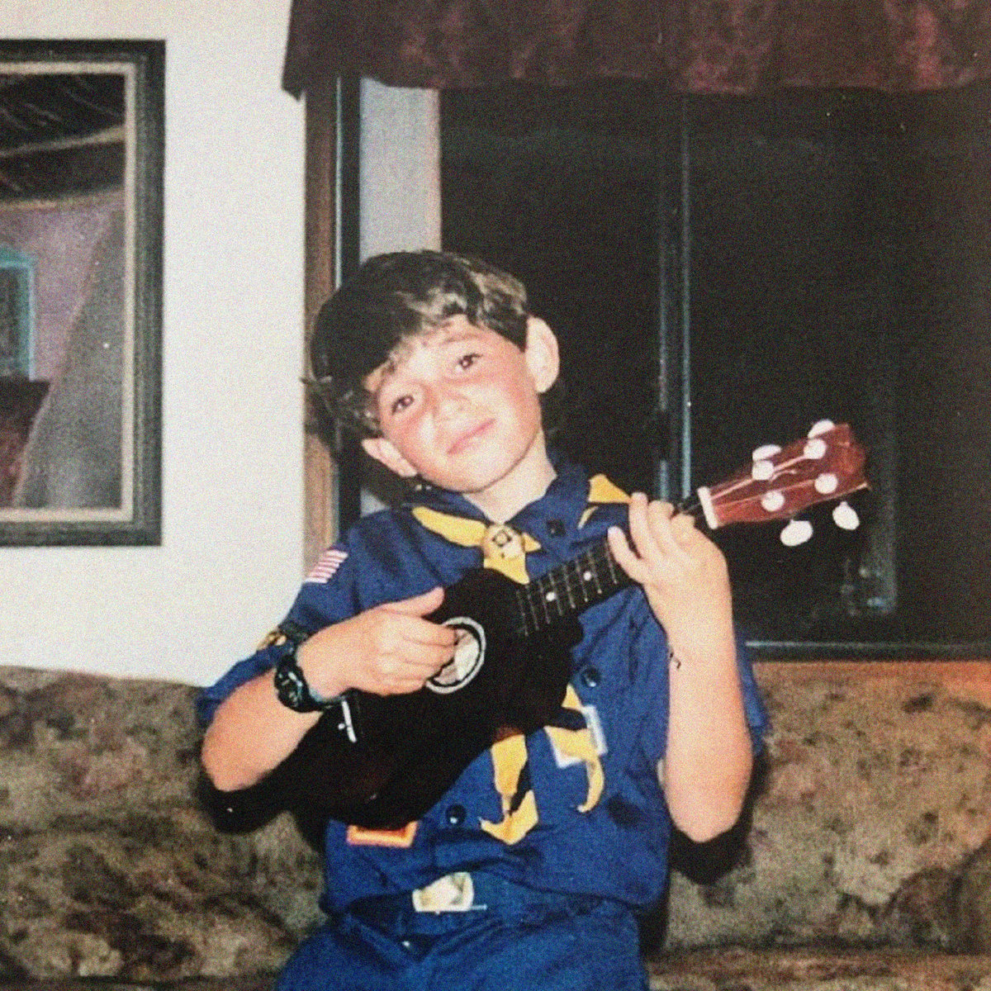
second … who am i?
a person who has no business writing a musical
a person who wrote this musical
a person who LOVES to make and present PowerPoints
also i have a child and a full-time job so i am TIRED

Slide 6

third … bookmark this
joswellmaxeph.github.io/callback/TeamSite/
Discord Link
Calendar Link
Script Link
Song Demos

Slide 7
AGENDA
about the show
about the characters
about this production
logistics & expectations
what’s next
chill hang

Slide 8
THE SHOW

Slide 9
BACKGROUND
I have been writing this musical since age 12
That’s not literally true
What is true is that every song and story I have ever written has led directly to this moment
This show is me
This show is my life’s work

Slide 10
MORE BACKGROUND
adjective, not noun
adjective, not noun
CALLBACK is an original comedy musical.
It isn’t a Musical – it’s really just some songs that happen to have some acting in between them.
I’m not a playwright or musician or producer or singer (just listen to the demos) – I am a songwriter. This is not a musical – it is music.
As all things are
(Thomas Carlyle quote where he says anything examined deeply enough will turn out to be musical)

Slide 11
THE SHOW
An aspiring comedian gets the opportunity of a lifetime when a streaming service holds local auditions.
This show is about wanting to put your exact full self on display and be seen, understood, and loved for who you are.
Alt titles include - Imposters Theater: The Musical
Live, Laugh, Love: The Musical

Slide 12
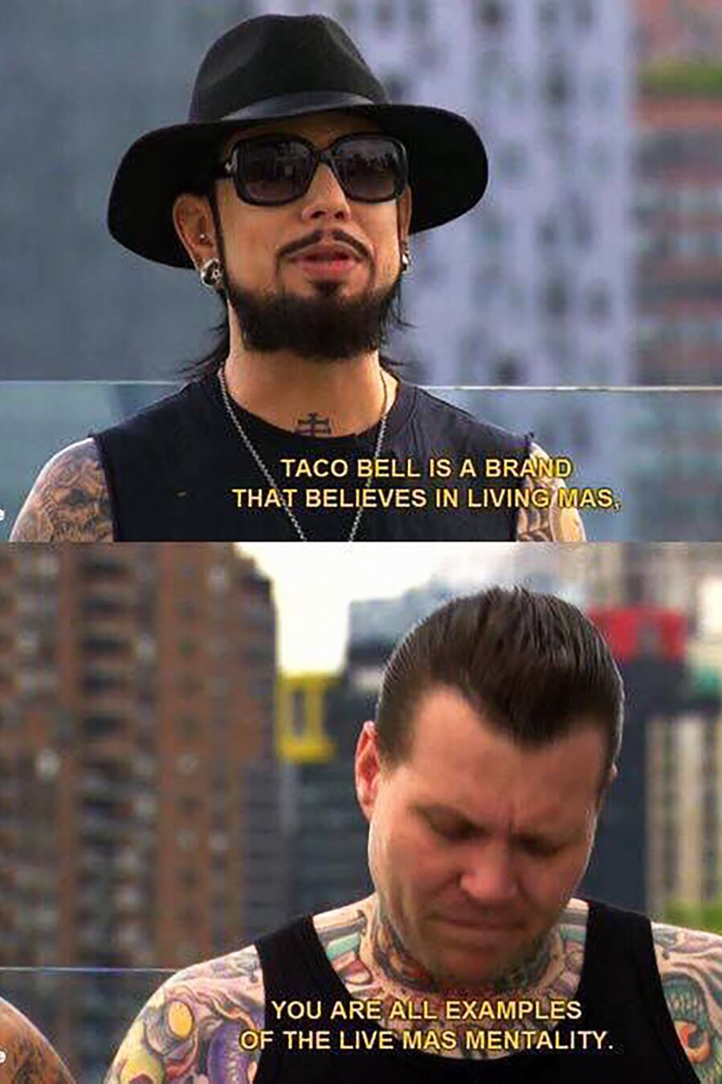
CALLBACK
SHOW
AND LAUGHING AND LOVING
LAUGH LOVE

Slide 13
THE CHARACTERS

Slide 14
THE CHARACTERS
SHAWN: Sarah Demetruk – a main character with main character syndrome
DANNY: Abby Wolgamuth – Robin Williams in Good Will Hunting
VIC: Nick Sobotka – the most toxically confident and decadently fabulous villain
PHYLLIS: Grace Elliott – a businessperson who secretly sorta hates business
MEL: Dana Bye – teacher who cares a LOT which can be negative or positive (Ryan Santa)
CASEY: Joseph Lewis – old head who is a staple of the community and has seen it all
KIERAN: Megan Roth – someone just starting to make improv their entire personality
JESSE: Brianna Hohenfeld – a classic Gen Z individual
EVERETT: Joe Erickson – basically Lorne Michaels (SNL) + Sam Reich (Dropout TV)
TINA: Sam dropped out ☹
*everybodys nb

Slide 15
THIS PRODUCTION

Slide 16
THIS PRODUCTION: TEAM
Joseph S. Maxwell: Director 🫠🫒🛢️👀
S.D.K. Boyle: Music Director
Jonah Raider-Roth: Assistant Director

Slide 17
THIS PRODUCTION: “INDEPENDENT”
This is an “independent” production at Imposters Theater.
That means this group is responsible for everything!
And we will receive very little support from the theater itself.
BUT we have complete creative freedom.
This will be an extremely collaborative process by necessity.
We are doing this ourselves and I’m in charge and I have trouble being authoritative so I am going to “no worries if not” my way into a full theatrical production and I am also going to take this like way too seriously but it’s also like nbd so don’t even worry about it it’s fine.

Slide 18
THIS PRODUCTION: WORK
Notes:
The thing that will bring this show to life is not talent, ingenuity, creativity, intelligence, magic, spark, anything like that. It’s work. Labor is what it will take to make this exist. Conceptualizing a perfect show is easy. Executing any show at all is hard. Scheduling, focusing, practicing, reading the script 250 times, that stuff involves zero creativity, zero talent, zero specialty.

Slide 19
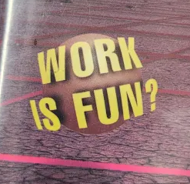
CALLBACK KICKBACKS
We will schedule some optional team outings to help build cast chemistry and help us work well together. Ideas include:
| Karaoke | Movie Night | Beach Day | PowerPoint Party | Baseball Game | | Thrift Day | Fundraiser Show |

Slide 20
LOGISTICS & EXPECTATIONS

Slide 21
YOUR RESPONSIBILITIES
Memorize your lines (off-book date tbd)
Learn your songs
Make yourselves available
Attend scheduled rehearsals
Check the Discord at least once per day
Adhere to deadlines and do other stuff you say you are gonna do it
Be flexible because like 90 things will probably change

Slide 22
SCHEDULING
Calendar linked from the Team Site – please add it to your own!
ALL HANDS ON DECK meetings – table read, on-stage rehearsals, tech week
TABLE READ – TO BE SCHEDULED
Tuesday, August 5 (6-9pm) - REHEARSAL @ IMPOSTERS (we beg michael for the stage)
Tuesday, August 12 (6-9pm) - REHEARSAL @ IMPOSTERS (we beg michael for the stage)
Sunday, August 24 (10am-1pm) - REHEARSAL @ IMPOSTERS STAGE
Every night week before run (Aug 25+26+27+28) - Somewhere

Slide 23
WHAT’S NEXT

Slide 24
WHAT’S NEXT FOR CREW
Building the rehearsal schedule
Starting with the “ALL HANDS ON DECK” rehearsals
Then moving onto more specific rehearsals
Everyone please make sure your availability is up-to-date in the spreadsheet 😌
Locking the script
I am currently working on this, though it will not change too drastically
The version at the table read will have some room but not much room to change
Begging Michael Busch to give us time on the stage
Will this happen? Maybe

Slide 25
WHAT’S NEXT FOR YOU
Read the script
Download the demos
Start learning your parts
right now: hang out!

Slide 26
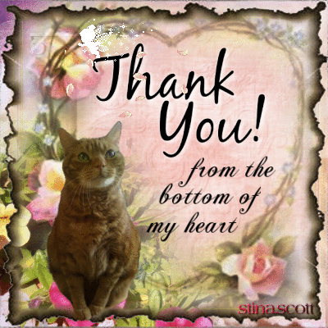



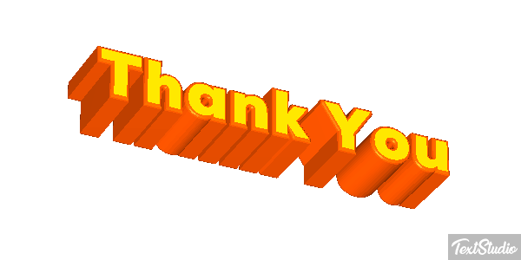
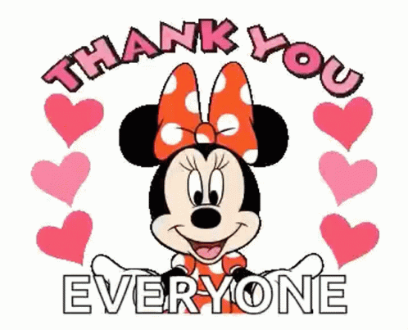
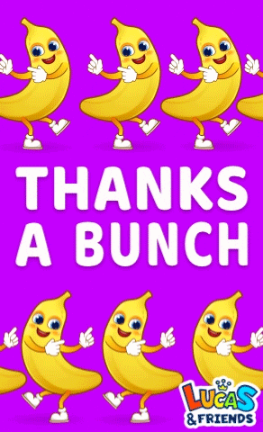
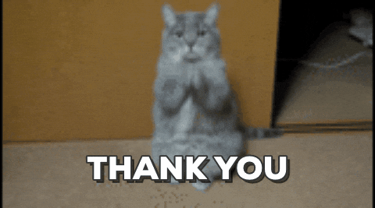

again … thank you

